Slide 1
Data Cleaning and Uploading Process for CRM

Slide 2
Content
Part 1 - Data Cleaning for Marketing (Subscribers)
Part 2 – Data Cleaning of Accounts for CRM Country Implementation

Slide 3
Part 1: Cleaning and Uploading Subscriber Data into CRM

Slide 4
Cleaning and Uploading Subscriber Data - Process
Service Now Change Request – Marketing Cloud
(PM valida con Romina Nicaretta si puede proseguir - approval)
Assign to EbFactorydata clearner through Service Now (with Data Cleaning Rules)
EbFactory does Data Cleaning according to templates sent by Globant and Rules set by IDB
EbFactory uploads data in UAT following process and best practices set by Globant
EbFactory PM does quality assurance of data uploaded into the CRM following IDB rules and document proof in ServiceNow
Ebfactory through ServiceNow gets approval from Romina Nicaretta to move into production
EbFactory PM creates a ticket in Service Now to move data into production moves into production and does final quality check before closing ticket.**
1
2
3
4
5
6
7
Obs once data is in production, we need to define the workflow for the onboarding journey for these subscribers)

Slide 5
Step 1 and 2– ServiceNow Change Request – Marketing Cloud
Client enters ticket in ServiceNow --> EbFactory PM receives request
Validation questions for requests upload subscriber data for Marketing Cloud
How this list was compiled? Here we want to understand whether they bought this list. It needs to be compiled by IDB within the context of an event organized by the Bank or a landing page.
If it was an event, please get the name of the event, when it occurred, which department organized and what was the topic. If not ask the person to explain the context in which the emails were acquired.
Does the people on that list expect to be receiving an email invitation from the IDB in order to become subscribers?
Once you have the answers, please discuss with Romina how the data cleaning process will be and how the onboarding process will work. This is a process we need to discuss with Globant about the templates during the training to finalize documentation.

Slide 6
Step 2: Data Cleaning Process for Subscribers
Receive files to be cleaned, define data cleaning rules for contacts and campaign tables after Step 1 validation
Upload a and b tables in UAT, do insert of table c for empty fields, and then create a relational tables of contacts members of a campaign by joining IDs or contact and campaign
Create 3 tables:
a. for campaign,
b. for new contacts that do not exist in the CRM and must be created,
c. for contacts that already exist and for which information must be inserted for fields that are incomplete

Slide 7
Step 3 – Cleaning Subscriber Data (Part1)
Contact Table Cleaning
Fields (to be validated with Globant): FirstName, LastName, Email, Self Reported Institution Type, Self Reported Institution Name, Title, Marketing Role, Twitter, LinkedIn, Country of Residence, Country Code
Normalize the fields and eliminate invalid emails through Brite Verify
Produce a short 1-pager with main rules used for cleaning data
Formatting: CSV, Comma Delimited, UTF 8
FirstName and LastName Format: First letter big Caps rest small Caps. E.g. Romina; if field is empty replace with Space hyphen Space (“ – “)
Email: Use Validation for Brite Verity – Use IDB Account. Eliminate invalid emails
Self Reported Institution Type (use pick list provided by IDB); Discuss with Romina more detail rules to assign self reported institution type based on email characteristics.
Self Reported Institution Name and Title: Open text field, Frist Letter Big Caps others small Caps.
Marketing Role (use pick list provided by IDB); discuss with Romina in more detail rules to assign marketing role based on information based on title if provided by subscriber.
Twitter: always use Twitter handle @TwitterName
LinkedIn: Always full link to web site
Country of Residence and Country Code: Use table provided by IDB, Discuss with Romina in more detail rules to assign country of residence based on email haracteristics.
Contact Table Comparison
Download CRM subscriber data and compare with table from IDB client to produce 2 tables:
Table with new contacts that do not exist in the CRM
Tables with existing Contacts. In this case we should only upsert information for the fields that are empty in production. For those with existing information in production, do not modify.

Slide 8
Step 3– Cleaning Subscriber Data (Part2)
Campaign Table
Campaign Table Fields for Subscribers (to be validated with Globant): Campaign Name, Description, Topic, Department, Division, Formatting: CSV, Comma Delimited, UTF 8
This table must be completed by Marketing Administrator. Globant must provide template and guidance about what fields are needed.
Campaign Member Table
Campaign Member Table: TDB. Wait for Globant template

Slide 9
Step 4 and 5– Uploading Data in UAT and Quality Check
Uploading Data in UAT: Globant will provide documentation and steps on how to do it.
Important points to consider: For new subscribers it is a simple process of creation. However, for exiting subscribers it is a process of inserting information that was missing and not changing fields that already contains information. Please discuss with Globant what is the best way of doing it.
UAT Quality Check:
Verify the number of records created is the same as in the original file
Verify the number of contacts updated is the same as in the original file
Verify if Campaign was created
Verify if the number of campaign members matches the original file
Pick two or 3 contacts of the original file and verify if the fields in the CRm match what was in the original file.
Do screeenshots of this step, attach to a word document and attach to the Service Now Ticket in order to move into production.

Slide 10
Step 6 and 7– Approval and Moving into Production
Approval: Please let Romina Nicaretta and system Administrator Carlos Lopez know UAT testing has been performed and that data will move into production at a specific date.
Move into production: Please check the process with Globant.
Important points to consider: For new subscribers it is a simple process of creation. However, for exiting subscribers it is a process of inserting information that was missing and not changing fields that already contains information. Please discuss with Globant what is the best way of doing it.
Quality Check: Please perform the same quality check as in the UAT environment. No documentation needed at this stage.

Slide 11
Part 2: Cleaning Account and Contact Data for Country Implementation

Slide 12
Process for CRM Country Onboarding
Timeframe: 1 month. It needs to meet the deadline for when CRm team goes to country to provide training and onboarding
Cleaning, normalization and deduplication of Accounts
Validation with Data Champions
Create ServiceNow Ticket to Upload Data in UAT and Production
UAT Quality Assurance and Move to Production
1
2
3
4

Slide 13

Step 1: Data Cleaning Process for Accounts
LFM Account Data of Active Operations for Selected Countries for Onboarding (CSV file – pre-cleaned)
Compare both tables to produce single consolidated file of Accounts that must remain in CRM and other file of Accounts that must be eliminated from CRM.
Download Account Data for Countries Selected for Onboarding from CRM Production Environment (CSV file )
Send File to Data Manager for review and manual corrections
Normalization rules:
Globant to provide template for account object
Here is example of the documentation and cleaning done for Chile (see summary called
See last slide for normalization rules for each Account field
Rules for comparing LFM and CRM Account Tables:
File 1: Create a CSV file with accounts that are not part of LFM List and that have no contacts or opportunities. This file will be sent to Data manager for validation and, if approved, enter a ticket in Service Now so these accounts can be erased.
File 2: Create a CSV file with a list of Accounts that must be uploaded into the CRM (Accounts in the LFM List and those with Contacts and Opportunities)
Detection of Duplicates: When merging the tables detect duplicates by fussy joint by name and/or acronym. Consult Data Manager for merging rules to see what information must prevail.
Review by Data manager to identify potential international organizations for which specific descriptions and hierarchies must be created
After edits and review by Data manager, file will be sent to Country Data Champions for review and validation/corrections.

Slide 14
Steps 2, 3 and 4: Validation, Upload into UAT and Production
Step 2
Data manager is responsible for entering Snow Ticket and approving deletion of accounts
Data manager is responsible for delivering and giving instructions to Data Champions on what they need to rvew in the file of accounts to be uploaded in the CRM
Data manager is responsible for coordinating with EbFactory additional corrections to be done for the production of the final file to be uploaded in UAT environment.
Step 3
Data manager is responsible for creating ticket in SNOW for uploading in UAT and production
Step 4
EbFactory Uploads data into UAT
File should overwrite the information that is in UAT for accounts
For merger of records, work on specific rules with Data manager
Please review with Globant activities to update and merge records in the CRM
UAT Testing parameters, please produce documentation and attach to ticket
Verify number of accounts for country matches the number of accounts in file for upload
Verify if accounts deleted cannot be found in UAT
Spot check of 3 accounts and see if fields were properly uploaded.
Approval by data manager and move into production
Perform same verification as done in UAT testing

Slide 15
Documentation and File Storage
Romina will create a Microsoft Teams Group with your iadb.org emails in order to manage the internal communications regarding data load requests for Marketing and Countries.
Under this team, folders should be created for each request, based on department Name.
Save all original data files sent by department
Save a brief document with all cleaning rules performed
Savel all cleaned files done by EbFactory
Save all documentation for UAT Testing

Slide 16
Post- production upload – Other Activities to be aware
Once accounts are uploaded into CRM, Data Champions will review them in production and validate and complete missing information inside the CRM.
We may receive request to upload massively contacts into the CRM
If this happens this will be a separate workflow post-implementation in which we will need to join contacts with accounts by account name. For those accounts that do not exist we will need to create them first before uploading contacts.

Slide 17
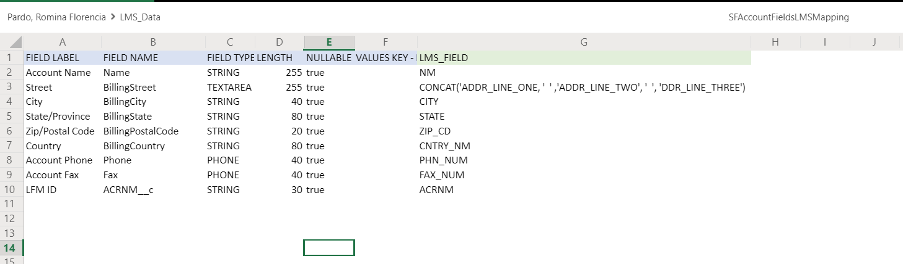
Data Normalization Rules – Accounts – Main Fields
Name: First letter in big caps and rest in small caps. E.g. Banco Nacional de Obras y Servicios Públicos S.N.C
Abbreviation: BANOBRAS
Street: Prolongación Paseo de la Reforma 600 – 320 , Santa Fe
Postal Code: 01219
City: Ciudad de México
State: Ciudad de México
Country: Mexico (all accounts must have a country)
Phone/Fax: Always add + and Country code in front of all numbers

Slide 18
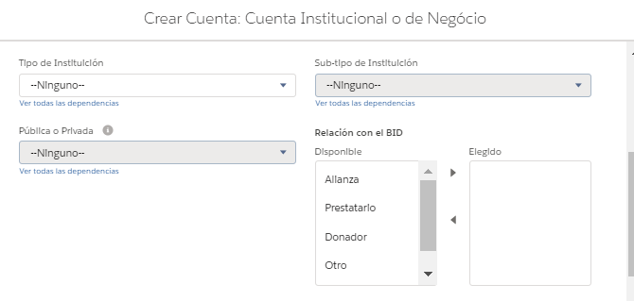
Data Normalization Rules – Accounts – Other Fields
Institution Type (picklist) – To be manually defined by data manager
Public or Private (picklist) – to be manually defined by data manager
Relationship with IDB (picklist): for all accounts with LFM ID, it must be Borrower

